Slide 1
Do Now
Set up the sixth question from the review quiz:
Given the equation: 90 = 5 + 2t + 3t² find all solutions for t.

Slide 2
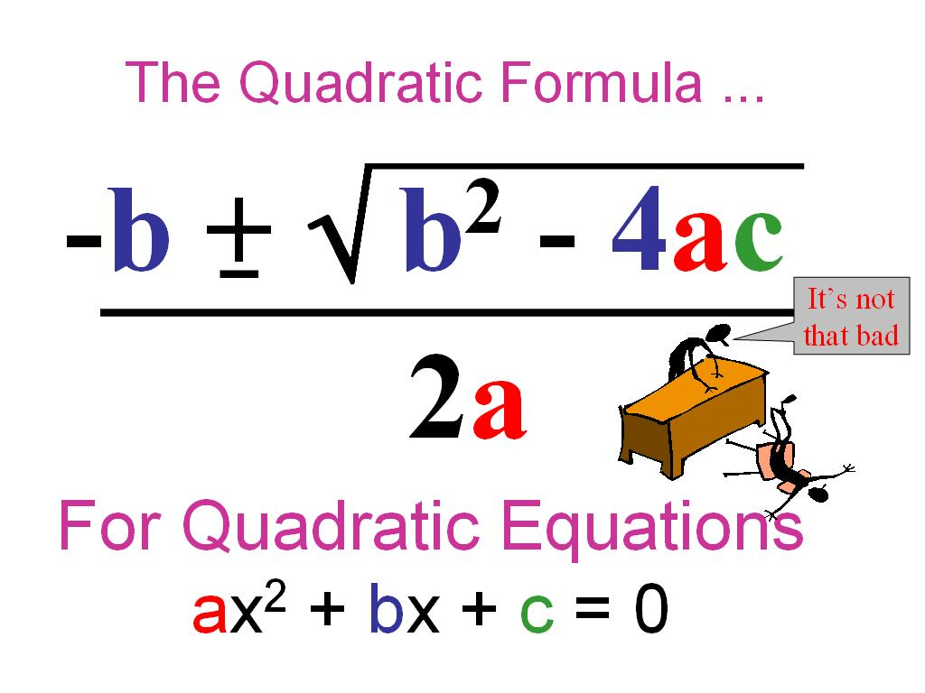
The quadratic equation

Slide 3
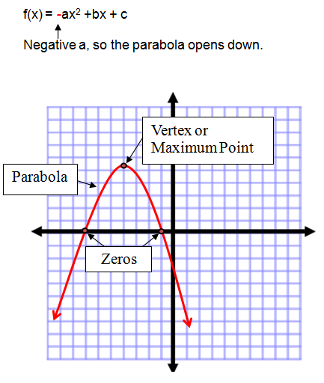
What does it all mean?

Slide 4
This Week
Monday-Examine problems with constant velocity.
Tuesday-Velocity continued.
Wednesday- “Buggy” Lab.
Thursday-Review for quiz Friday.
Friday-Quiz on subjects from weeks 1&2.

Slide 5
Quiz Material
Unit conversion (Dimensional Analysis)
Scientific Notation
Measurement
Position vs. Displacement
Constant Velocity Problems

Slide 6
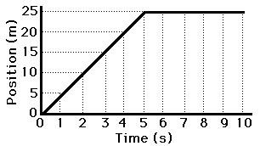
Determine the slope of the graph: 0-5 & 5-10 Seconds. Give an example of this motion.

Slide 7
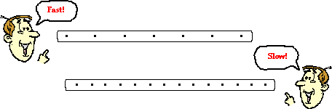
Ticker Tape Diagrams

Slide 8
Example
A car leaks oil at a rate of 1 drop per second. You follow the trail and can see that there is a drop in the road every 5 meters.
How fast is the car going?
If there are 12 dots, how far did the car travel?

Slide 9
Formula for Speed
S=d/t
S-Speed
d-distance traveled
t-time
How can I manipulate this formula?

Slide 10
Your Turn
The car turns the corner and you notice that the dots are now 3 meters apart. The car travels down the street for a total of 10 seconds. How far did it go?

Slide 11
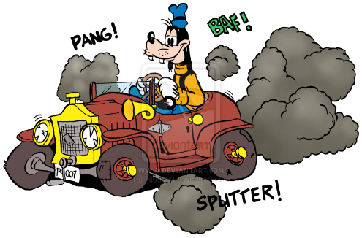
S=d/t
Goofy’s car drips oil every half second. It leaves a drip every 2 cm. What does Goofy’s car leave when he drives across your notes for 4 seconds? Draw Goofy’s oil trail.

Slide 12
Goofy’s Journey
If Goofy is going 42cm at 1.5cm/s, how long does it take him to make the journey?
He then goes 2.5cm/s for 6 seconds. How far does he travel?

Slide 13
Average Speed
Nathan in trying to catch Ari. Ari runs down the a hallway (120m) in 20 seconds. He then hides in the broom closet for 15 seconds to let Nathan pass him by. He runs back to where he first started in 25 seconds.
What was Ari’s average speed?

Slide 14

What was Ari’s average speed after 35 seconds?

Slide 15
Average Velocity
V=Δx/t
V-velocity
Δx-displacement
t-time
Write this formula for t and Δx.

Slide 16
Average Speed vs Average Velocity
Units are the same.
For velocity, direction matters.
If something moves back toward where it started, it has a negative velocity.
Distance traveled is always positive.
Displacement may be negative.

Slide 17

Gridiron Physics

Slide 18
The Engine that Couldn’t
A train goes travels at 5m/s for 7 seconds.
It then hits a steep hill and slows to 2 m/s for 3 seconds before blowing its engine.
It then slides back down the hill at 2m/s for 2 seconds before applying its emergency breaks.
What it the displacement of the train after each leg of the journey?

Slide 19
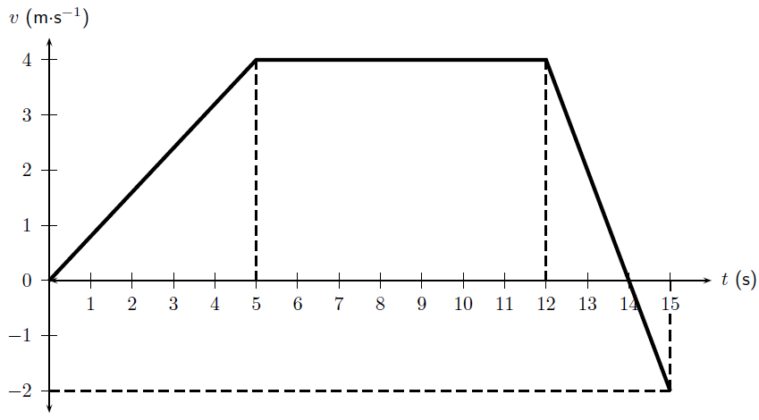
V-t Diagram

Slide 20
Velocity Time Graph
Lets revisit the engine that couldn’t.
Create a data table in your notes.
Include time, distance traveled, speed and displacement.

